Slide 1
Lecture 13
Tree

Slide 2
Infix, Prefix and Postfix Notation
We can represent complicated expressions, such as compound propositions, combinations of sets, and arithmetic expressions using ordered rooted trees.
For instance, consider the representation of an arithmetic expression involving the operators + (addition), − (subtraction), ∗ (multiplication), / (division), and ↑ (exponentiation).
We will use parentheses to indicate the order of the operations.
An ordered rooted tree can be used to represent such expressions, where
the internal vertices represent operations, and the leaves represent the variables or numbers.

Slide 3
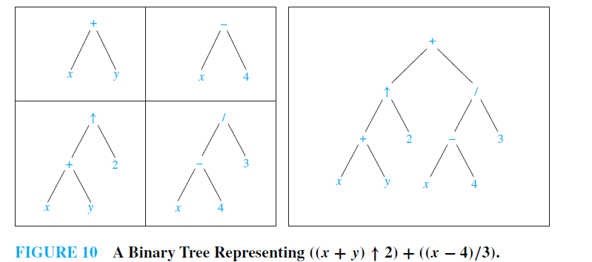
Example
What is the ordered rooted tree that represents the expression ((x + y)↑2) + ((x − 4)/3)?
Solution

Slide 4
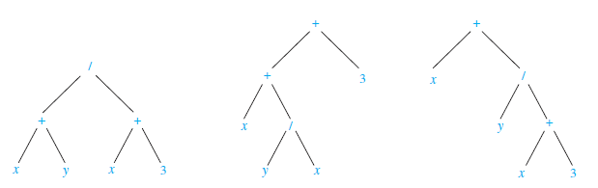
Infix form
An inorder traversal of the binary tree representing an expression produces the original expression with the elements and operations in the same order as they originally occurred, except for unary operations, which instead immediately follow their operands.
For instance, inorder traversals of the binary trees in Figure below, which represent the expressions (x + y)/(x + 3), (x + (y/x)) + 3, and x + (y/(x + 3)), all lead to the infix expression x + y/x + 3. To make such expressions unambiguous it is necessary to include parentheses in the inorder traversal whenever we encounter an operation.

Slide 5
Infix form-Continue
The fully parenthesized expression obtained in this way is said to be in infix form.

Slide 6
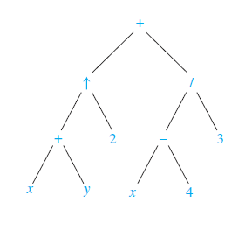
Prefix form
We obtain the prefix form of an expression when we traverse its rooted tree in preorder. Expressions written in prefix form are said to be in Polish notation.
Example
What is the prefix form for ((x + y) ↑ 2) + ((x − 4)/3)?
We obtain the prefix form for this expression by traversing the binary tree that represents it in preorder, shown in Figure .
This produces + ↑ + x y 2 / − x 4 3.

Slide 7
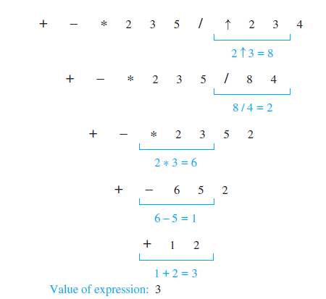
Evaluating a Prefix Expression-Example
What is the value of the prefix expression + − ∗ 2 3 5/↑ 2 3 4?
Solution

Slide 8
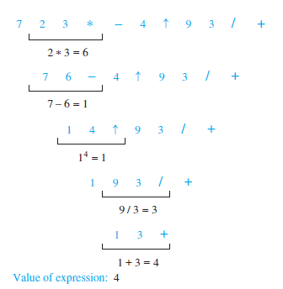
Example
What is the value of the postfix expression 7 2 3 ∗ − 4 ↑ 9 3/+?
Solution
The steps used to evaluate this expression by starting at the left and carrying out operations when two operands are followed by an operator.

Slide 9
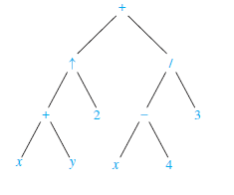
Postfix notation
We obtain the postfix form of an expression by traversing its binary tree in postorder. Expressions written in postfix form are said to be in reverse Polish notation.
Example
What is the postfix form of the expression ((x + y) ↑ 2) + ((x − 4)/3)?
Solution
The postfix form of the expression is obtained by carrying out a postorder traversal of the binary tree for this expression, shown in Figure . This produces the postfix expression: xy + 2 ↑ x 4 − 3 / +.

Slide 10
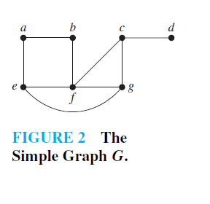
Spanning Tree
Let G be a simple graph. A spanning tree of G is a subgraph of G that is a tree containing every vertex of G.
Example
Find a spanning tree of the simple graph G shown in Figure 2.

Slide 11
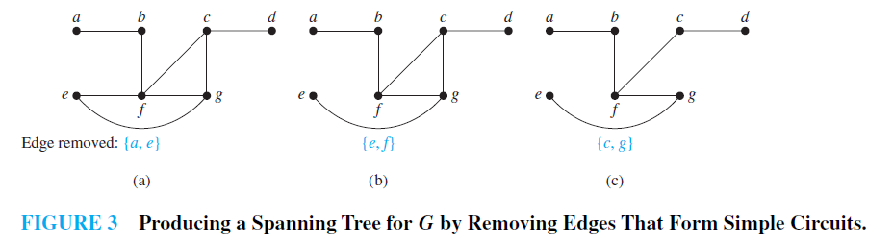
Solution
The graph G is connected, but it is not a tree because it contains simple circuits. Remove the edge {a, e}. This eliminates one simple circuit, and the resulting subgraph is still contains simple circuits. Next remove the edge {e, f } to eliminate a second simple circuit. Finally, remove edge {c, g} to produce a simple graph with no simple circuits. This subgraph is a spanning tree, because it is a tree that contains every vertex of G.

Slide 12
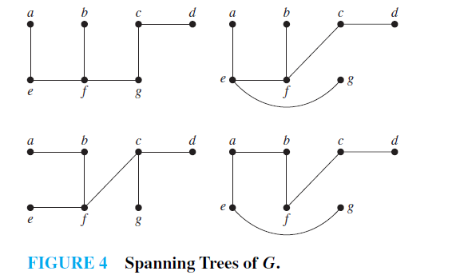
Solution-Continue
The tree shown in Figure 3 is not the only spanning tree of G. For instance, each of the trees shown in Figure 4 is a spanning tree of G.

Slide 13
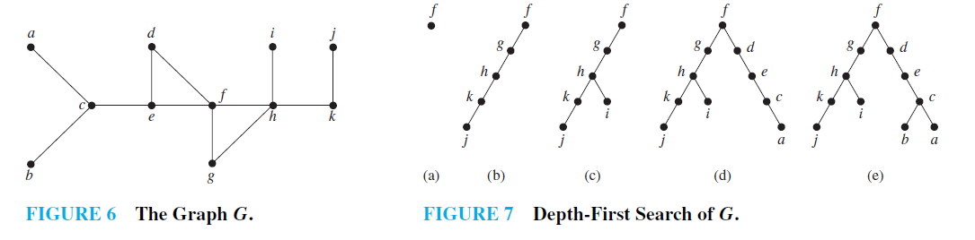
Depth –First Search
Instead of constructing spanning trees by removing edges, spanning trees can be built up by successively adding edges.
Depth-first search is also called backtracking, because the algorithm returns to vertices previously visited to add paths.

Slide 14
Continue
We arbitrarily start with the vertex f . A path is built by successively adding edges incident with vertices not already in the path, as long as this is possible. This produces a path f , g, h, k, j (note that other paths could have been built). Next, backtrack to k. There is no path beginning at k containing vertices not already visited. So we backtrack to h. Form the path h, i. Then backtrack to h, and then to g . From g backtrack to f. From f build the path f , d, e, c, a. Then backtrack to c and form the path c, b. This produces the spanning tree.

Slide 15
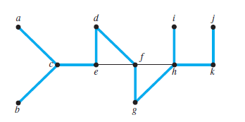
Continue
Figure: The Tree Edges and Back Edges of the Depth-First Search in Example .

Slide 16
Breadth-First Search
We can also produce a spanning tree of a simple graph by the use of breadth-first search.
Again, a rooted tree will be constructed, and the underlying undirected graph of this rooted tree forms the spanning tree.
Arbitrarily choose a root from the vertices of the graph. Then add all edges incident to this vertex. The new vertices added at this stage become the vertices at level 1 in the spanning tree.
Arbitrarily order them. Next, for each vertex at level 1, visited in order, add each edge incident to this vertex to the tree as long as it does not produce a simple circuit.
Arbitrarily order the children of each vertex at level 1. This produces the vertices at level 2in the tree.
Follow the same procedure until all the vertices in the tree have been added. The procedure ends because there are only a finite number of edges in the graph.
A spanning tree is produced because we have produced a tree containing every vertex of the graph.

Slide 17
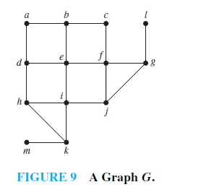
Example
Use breadth-first search to find a spanning tree for the graph shown in Figure below .
Continue

Slide 18
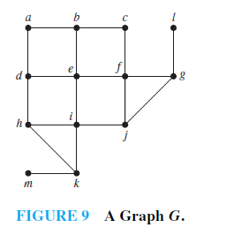
Continue
We choose the vertex e to be the root.
Then we add edges incident with all vertices adjacent to e, so edges from e to b, d, f , and i are added. These four vertices are at level 1 in the tree.
Next, add the edges from these vertices at level 1 to adjacent vertices not already in the tree. Hence, the edges from b to a and c are added, as are edges from d to h, from f to j and g, and from i to k. The new vertices a, c, h, j , g, and k are at level 2.
Next, add edges from these vertices to adjacent vertices not already in the graph. This adds edges from g to l and from k to m.

Slide 19
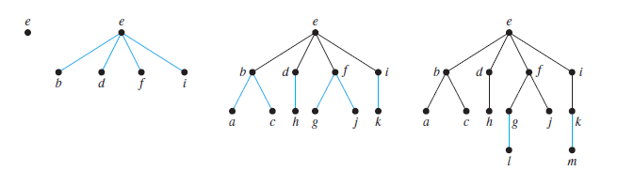
Continue

Slide 20
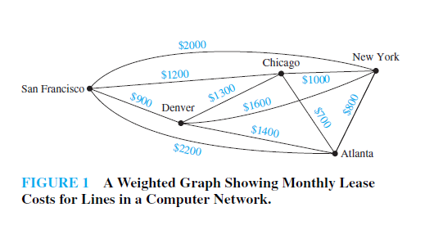
Minimum Spanning Tree
A minimum spanning tree in a connected weighted graph is a spanning tree that has the smallest possible sum of weights of its edges.

Slide 21
Minimum Spanning Tree
A company plans to build a communications network connecting its five computer centers. Any pair of these centers can be linked with a leased telephone line. Which links should be made to ensure that there is a path between any two computer centers so that the total cost of the network is minimized? We can model this problem using the weighted graph shown in Figure 1, where vertices represent computer centers, edges represent possible leased lines, and the weights on edges are the monthly lease rates of the lines represented by the edges.We can solve this problem by finding a spanning tree so that the sum of the weights of the edges of the tree is minimized.
Such a spanning tree is called a minimum spanning tree.

Slide 22
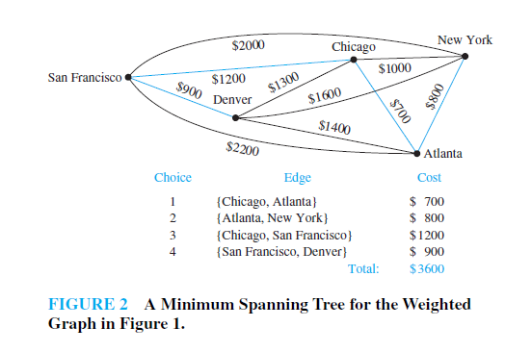
Prim’s Algorothm
Begin by choosing any edge with smallest weight, putting it into the spanning tree. Successively add to the tree edges of minimum weight that are incident to a vertex already in the tree, never forming a simple circuit with those edges already in the tree. Stop when n − 1 edges have been added.

Slide 23
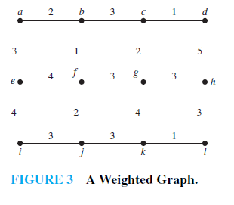
Example
Use Prim’s algorithm to find a minimum spanning tree in the graph shown in Figure 3.

Slide 24
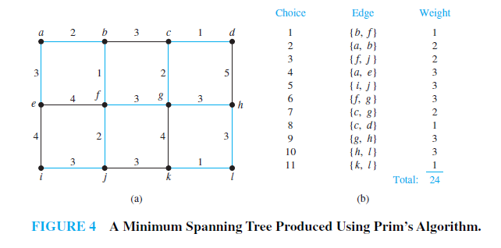
Solution
A minimum spanning tree constructed using Prim’s algorithm is shown in Figure 4. The successive edges chosen are displayed.

Slide 25
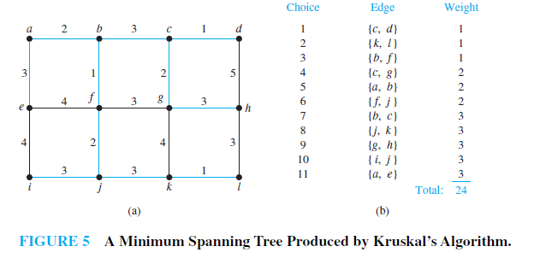
Kruskal’s Algorithm
Choose an edge in the graph with minimum weight.
Successively add edges with minimum weight that do not form a simple circuit with those edges already chosen. Stop after n − 1 edges have been selected

Slide 26
Continue
In Prim’s algorithm edges of minimum weight that are incident to a vertex already in the tree, and not forming a circuit, are chosen; whereas in Kruskal’s algorithm edges of minimum weight that are not necessarily incident to a vertex already in the tree, and that do not form a circuit, are chosen.

